Slide 1
MACHINE LEARNING
Course project
Presentation by:
ASHWIN UMADI (PES1201701517)
RAHUL R K (PES1201701552)
SHREYAS KULKARNI (PES1201700450)
CAR RESALE VALUE PREDICTION USING ML

Slide 2
ABSTRACT
New generation produces a variety of new cars.
Existing cars start losing their value as their age increases.
People look for the best price to sell the old ones.
This project gives a machine learning technique to predict the prices.

Slide 3
INTRODUCTION
Not everyone can afford a brand new car.
Approaching the dealers directly can lead to getting manipulated.
Help the customer in knowing the approximate price in the market.
Provides easy search for second hand cars.

Slide 4
PROBLEM STATEMENT
This project aims at building a car resale value prediction system based on a wide
range of car features by using a Neural Network approach.

Slide 5
FACTORS CONSIDERED FOR PREDICTION
Age
KM range
Brand
Model
FACTORS
Colour
Demand
Damage
Features

Slide 6
WHY ANN?
Here we preferred working with ANN for the following reasons:
Parallelized learning process leading to lesser learning time.
ANN used to solve diverse problems.
Low energy consumption.

Slide 7
METHODOLOGY
Data cleaning and visualization plays an important role.
When data is insufficient, the machine learns from the past experiences.
For factors with 2 options, we assign 0 & 1 to make the classification easier.
We make use of one hot encoder technique to get the categorical representation of the data while training.
Power also can be classified as high or low.
Histograms, pie charts, continuous graphs help in understanding the pattern.

Slide 8
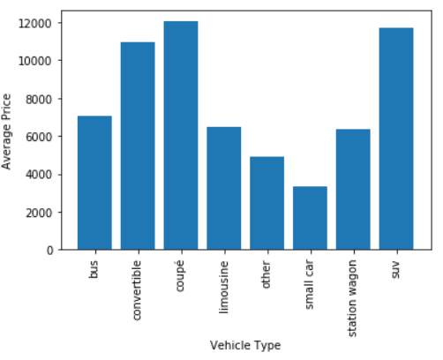
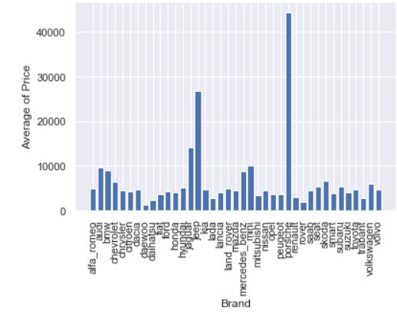
VISUALIZATION
SUV and Coupes have higher resale value compared to other variants.
This graph shows how the resale value depends on the brand

Slide 9
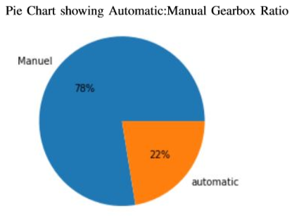
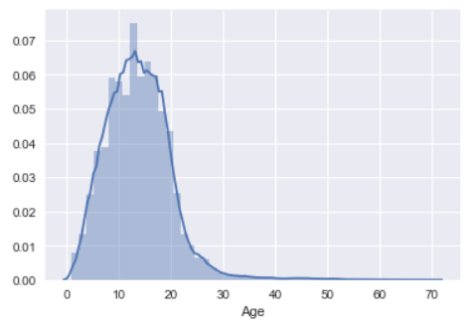
Histogram of age

Slide 10
Implementation of ANN
The ANN model was built using the keras library using the tensorflow backend
in python.
from keras.models import Sequential
from keras.layers import Dense, Dropout
The input layer consists of a number of neurons equal to the number of features in the
input vector (9 neurons)
The model consists of 6 layers out of which 4 layers are hidden.
Activation functions used are ‘ReLu’ and ‘linear’
The loss function used is ‘mean_absolute_error’ and the model optimizer used in ‘adam’

Slide 11
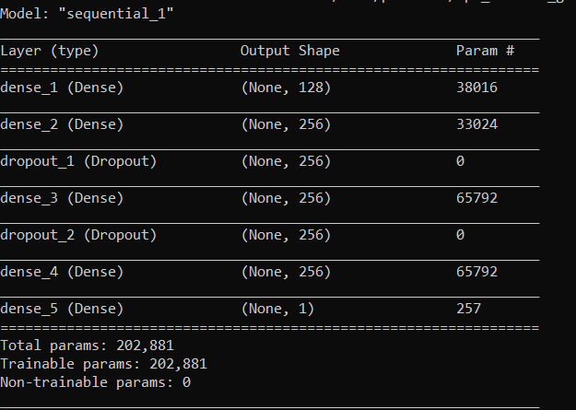
Model Summary
There are a total of 6 layers. (4 hidden)
Dropout is used for
Regularization.
Dense layer implements the operations
Provided in its parameters. (eg: Activation
Functions)

Slide 12
Datasets
The datasets consists of 257252 different values(rows) out of which 70% of the total is
Considered for training(154350), 15% of training is used for validation during train(25725) and
30% for test (77175).

Slide 13
Result and Analysis
Since linear activation function was used in the output layer of ANN R squared value is used to determine the accuracy.
R squared value is the proportion of variance in the observed data that is explained by the model. The value lies in the interval 0 to 1.
Folds | R squared value | Mean absolute error
60-40 | 0.862 | 0.1369
70-30 | 0.852 | 0.1402
80-20 | 0.867 | 0.1418
90-10 | 0.851 | 0.1384
Average | 0.858 | 0.1393

Slide 14
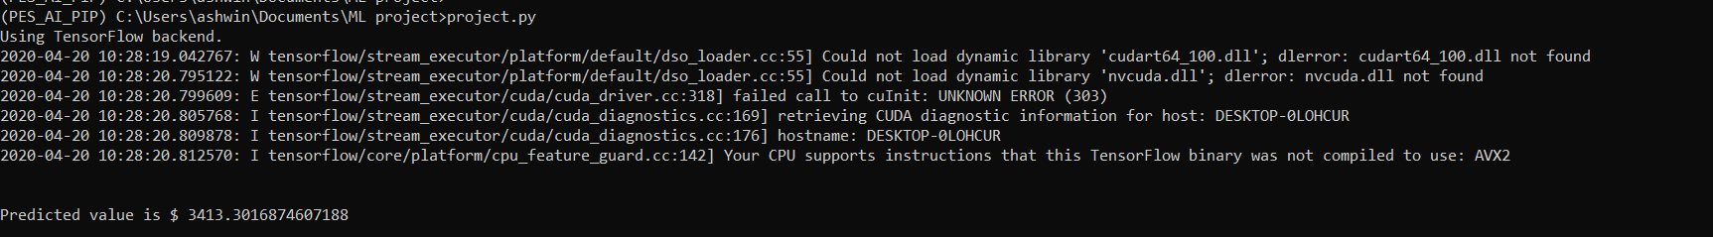
Output
The output shown says the predicted value for a test input is $3413.30

Slide 15
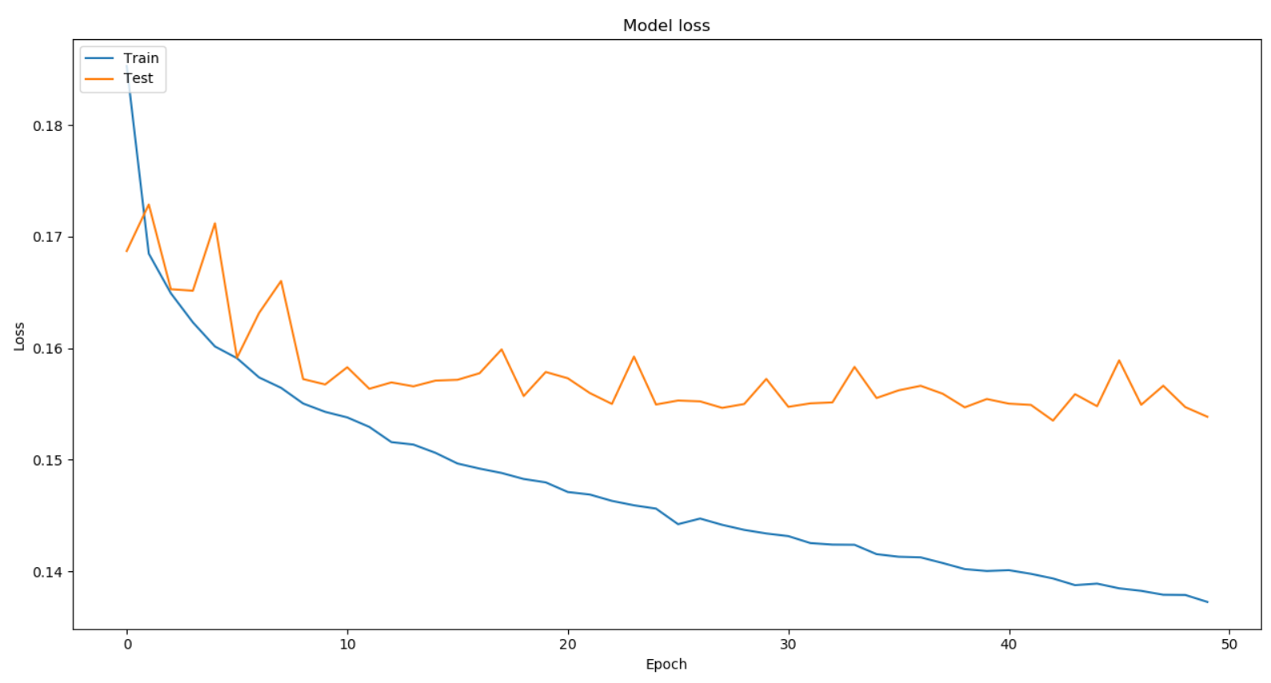
Comparison of Loss and number of iterations
As the number of iterations increases the model loss decreases and becomes constant after certain number of iterations.

Slide 16
Conclusion
The trained model gave R squared value of 0.858 and mean absolute error of 0.1393.
By the above statistics we can be sure that the predicted value will have an accuracy of 85%.
The accuracy can be increased by considering more attributes into account.
The use of ANN in predictions is more robust than any other techniques as the training time required is less, increase in the number of attributes requires just input layer dimensions to be changed.

Slide 17
Future Scope
Few attributes were not used from the datasets and few other attributes such as (stereo, GPS navigations interior accessories etc,) were not present in the dataset.
Considering these attributes will lead to better prediction of resale value.
Various boosting algorithms can be considered for better performance such as XG Boost.
Further we can develop a way of listing vintage cars separately and predict their prices.

Slide 18
References
Kaggle site for datasets
Cars 24 (To check the factors it uses for prediction)
https://www.cars24.com/
Car Price Prediction using Machine learning techniques.
http://www.temjournal.com/content/81/TEMJournalFebruary2019_113_118.pdf
Linear Regression Model applied in used vehicle market
https://towardsdatascience.com/car-selection-and-sales-day-prediction-8c4a474f9dca
IEEE paper: A New Model for Residual Value Prediction of the Used Car
Based on BP Neural Network and Nonlinear Curve Fit
https://sci-hub.tw/https://ieeexplore.ieee.org/document/5721273

Slide 19
Appendix
Code of Model training and weights generation
Code for prediction using model weights
Sample data

Slide 20
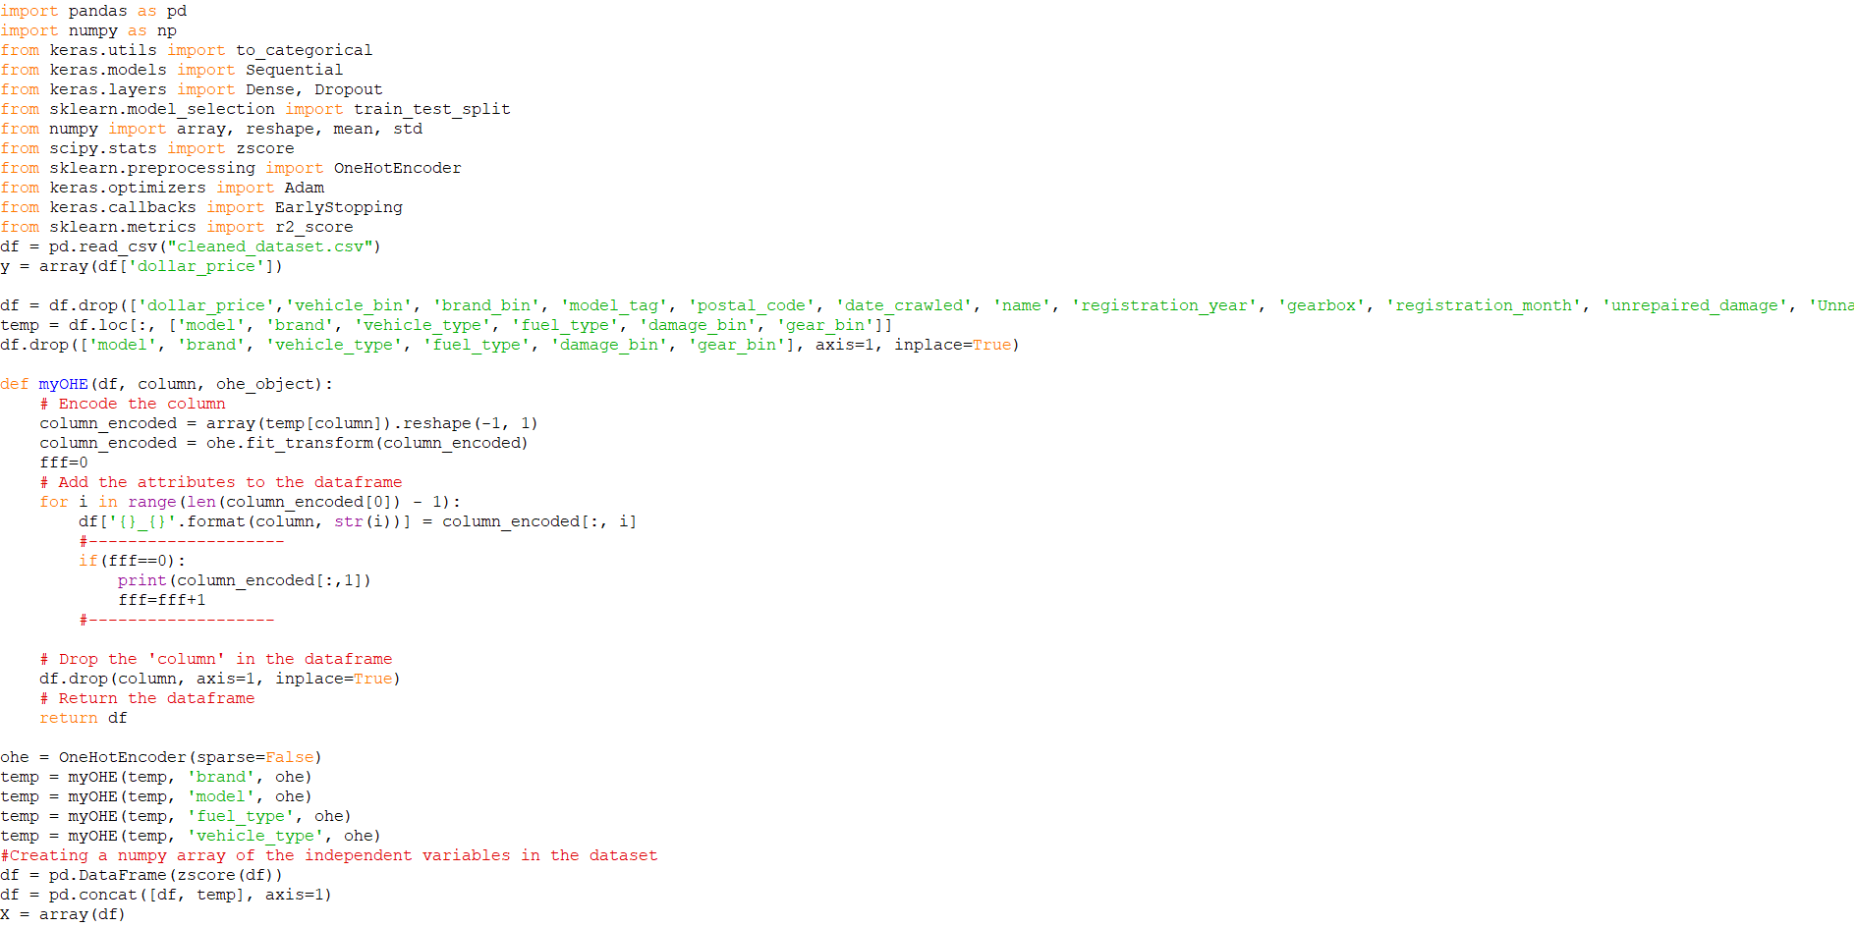
Code of Model training and weights generation

Slide 21
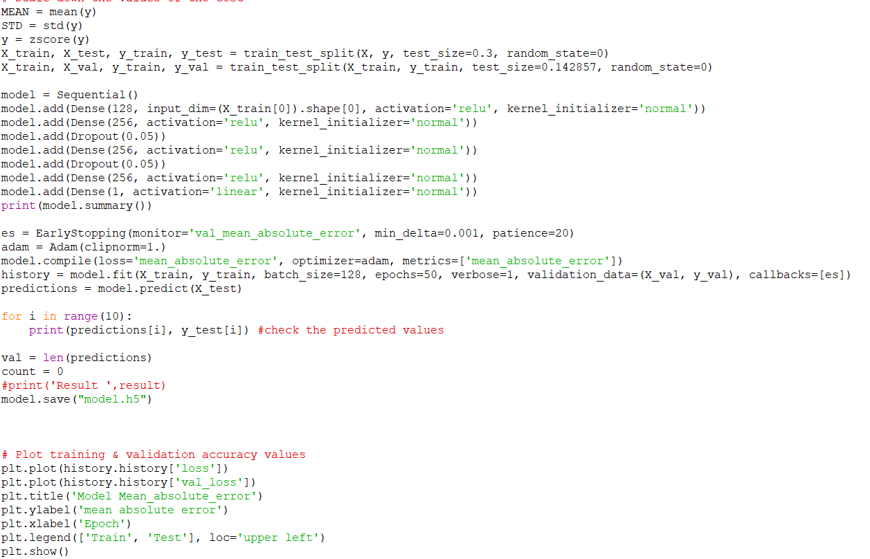
Code of Model training and weights generation

Slide 22
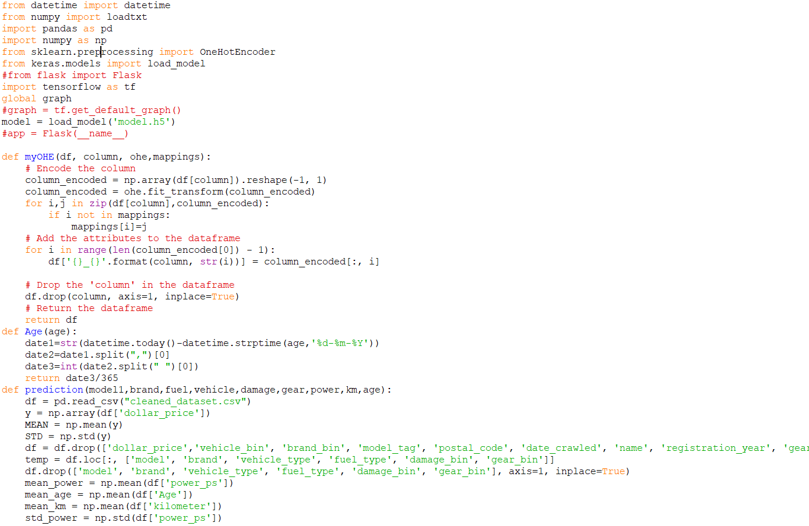
Code for prediction using model weights

Slide 23
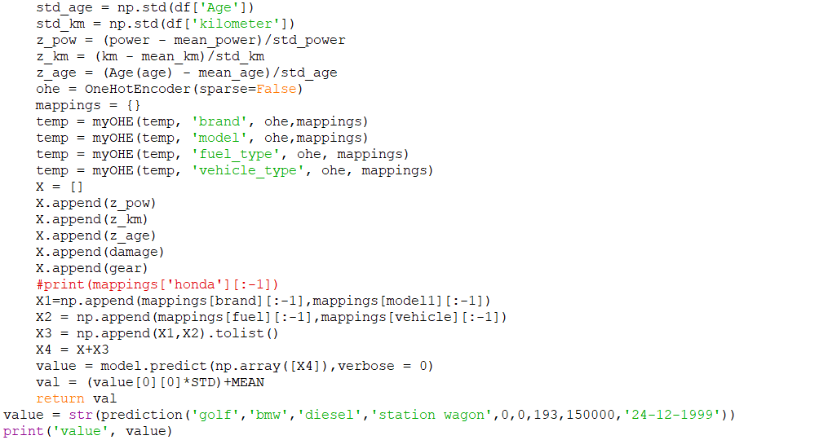
Code for prediction using model weights

Slide 24
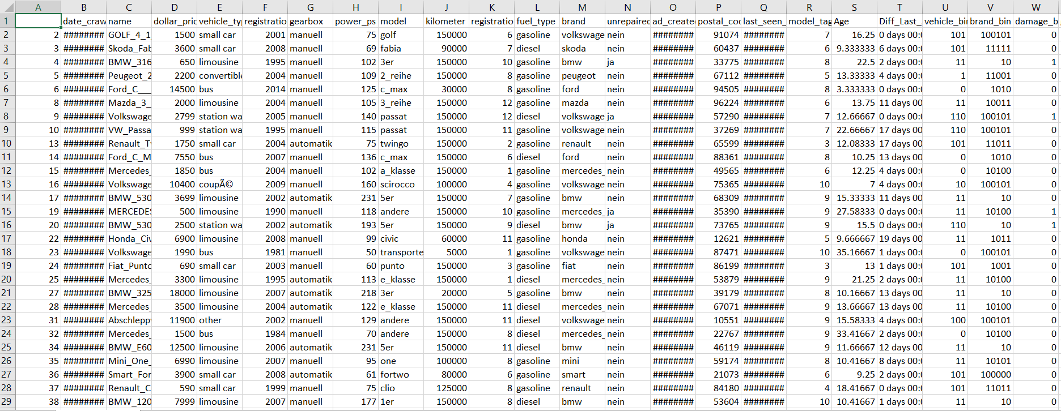
Sample Data

